Slide 1
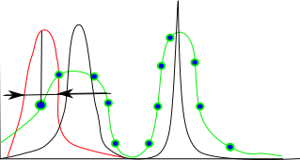
Data processing and Instrument resolution function: beyond FWHM (full width at half-max) approximation
4D – convolution type equation
Similar equation is used for radar signal analysis
We analyse the signal approximating resolution function using FWHM approximation
If resolution function is known, the equation can be inverted by various methods (MaxEnt, Convolution theorem, etc…)
Modern radars development goes into constructing optimal R(Q,E) functions, and use advanced signal processing to recover S(Q,E)

Slide 2
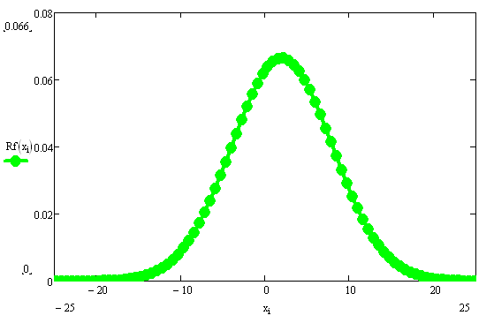
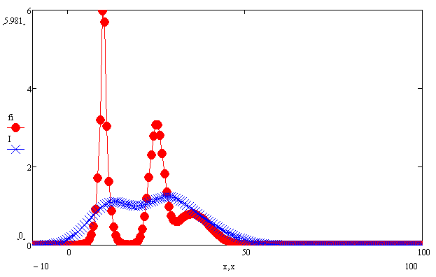
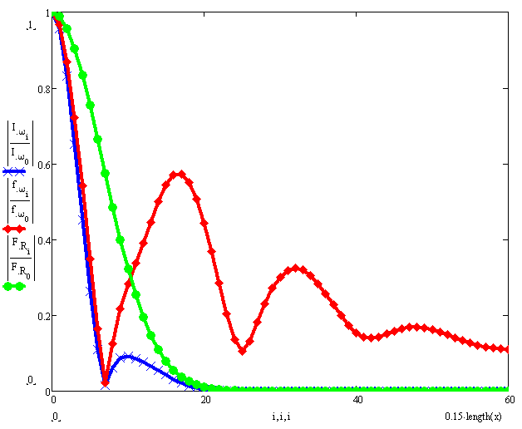
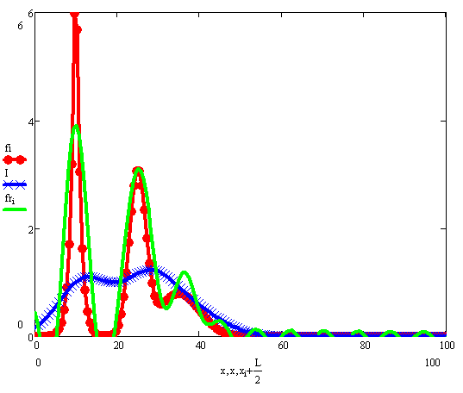
Inverting Convolution:
Bayesian analysis; || NI&M A287 1990 – Optimization of the resolution functions for neutron scattering;
Recovered signal
Cut-off frequency

Slide 3
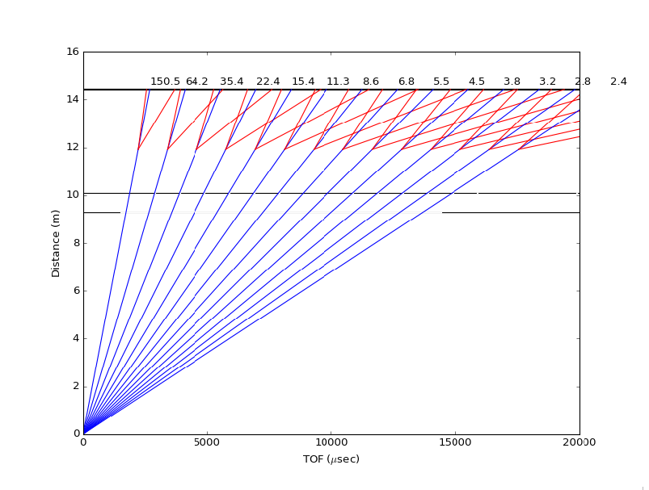
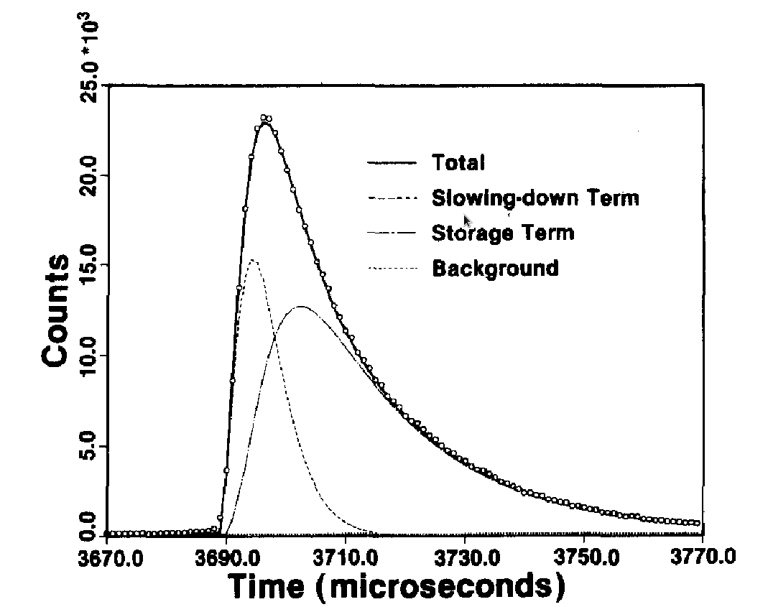
Reality check:
Monochromatic neutrons
time profile

Slide 4
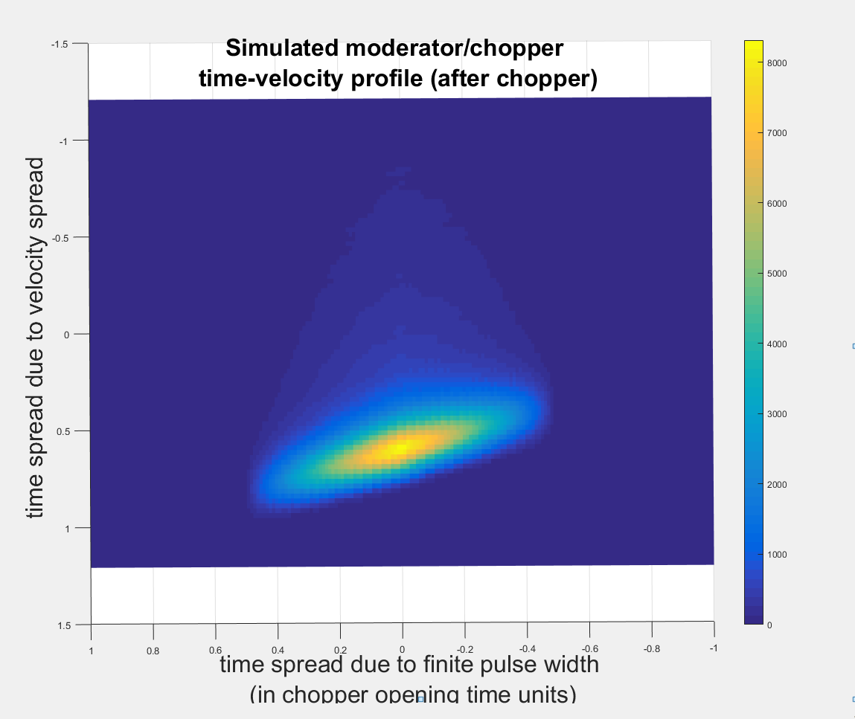
Modern chopper spectrometers are optimized to provide equal resolution
spread due to energy spread and pulse time shape.

Slide 5
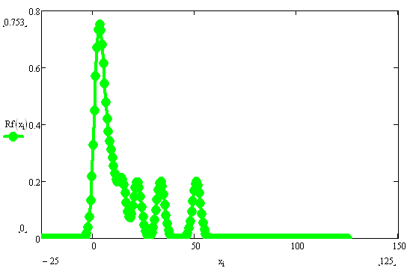
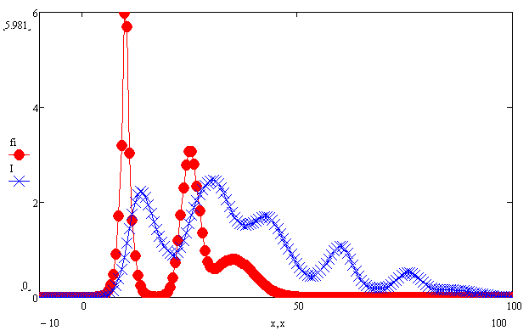
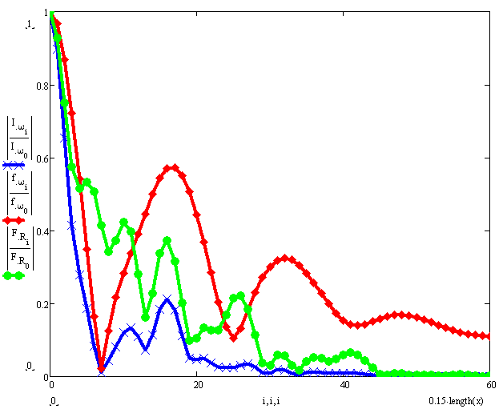
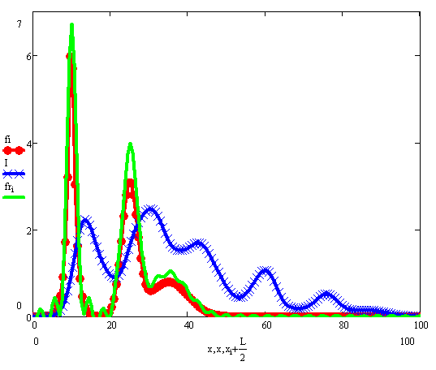
Different optimization: minimize pulse time spread. (different chopper)
Recovered signal
Cut-off frequency

Slide 6
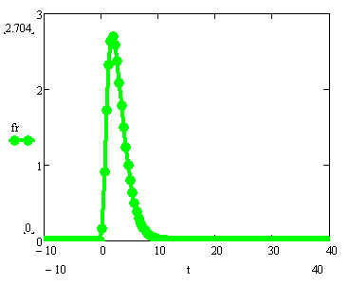
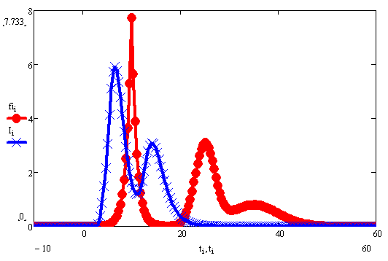
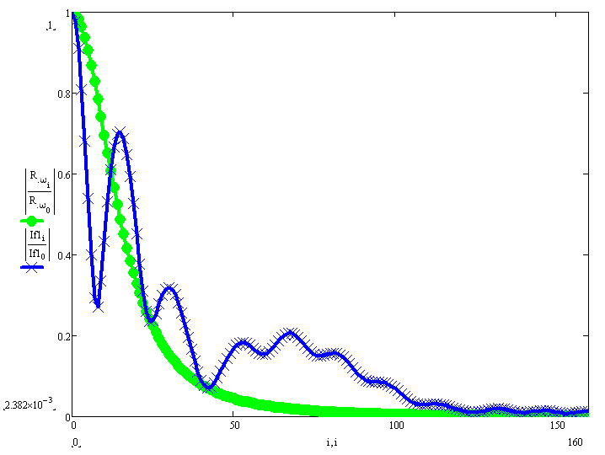
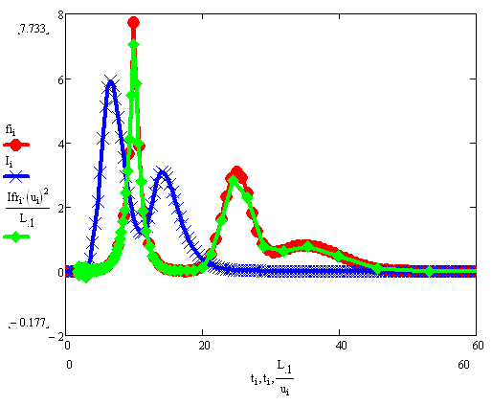
Different optimization: minimize energy spread (time focusing monochromator, different moderator?)
Recovered signal

Slide 7

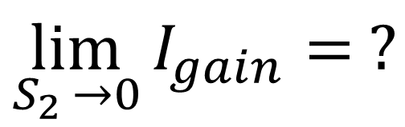

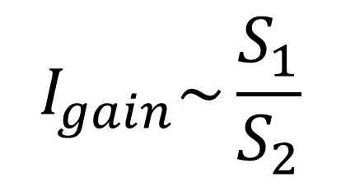


Time focusing monochromator: No problem with resolution and convenient for small samples?
$$I_{gain}\sim \frac{S_{1}}{S_{2}}$$
$$S_{1}$$
$$S_{2}$$
$$Q_{b}$$
$$\lim_{S_{2 }→0}{I_{gain}= ?}$$
$$Q_{b}$$

Slide 8
Moderator profile

Slide 9
Moderator profile and chopper cuts shapes
τ
1
Range1-> (E_chop = 150mEv)
t_range v_range
1.0e+03 *
-0.0017 5.3300
0.0003 5.3300
0.0039 5.5412
0.0059 5.5412
Range2-> (E_chop = 65.2mEv)
t_range v_range
1.0e+03 *
-0.0012 3.4854
0.0008 3.4854
0.0103 3.6725
0.0123 3.6725
v
2
Range3-> (E_chop = 35.8mEv)
t_range v_range
1.0e+03 *
0.0013 2.6060
0.0033 2.6060
0.0095 2.6784
0.0115 2.6784
Range4-> (E_chop = 22.5mEv)
t_range v_range
1.0e+03 *
0.0027 2.0747
0.0047 2.0747
0.0108 2.1203
0.0128 2.1203
v - moderator
3
4
5
Range5-> (E_chop = 15.5mEv)
t_range v_range
1.0e+03 *
0.0034 1.7210
0.0054 1.7210
0.0039 1.7230
0.0059 1.7230
Incorrect range as v||τ in moderator frame
t – moderator (in moderator opening times)

Slide 10
Time velocity distributions
Neutron’s time-velocity profile
rep 1 after chopper
Moderator profile rep 1 at chopper

Slide 11
Time-velocity distribution after inelastic scattering
Neutron’s time-velocity profile
after scattering
Neutron’s time-velocity profile
rep 1 at sample

Slide 12
2D time-velocity profile:
Velocity profile at sample at moment time t₀: (assuming velocity transfer only at )
assuming probability distribution of transfer Δv as :
Time profile of the pulse at detector position:

Slide 13
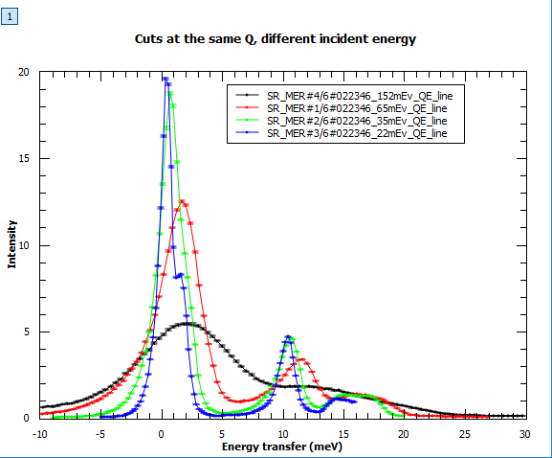
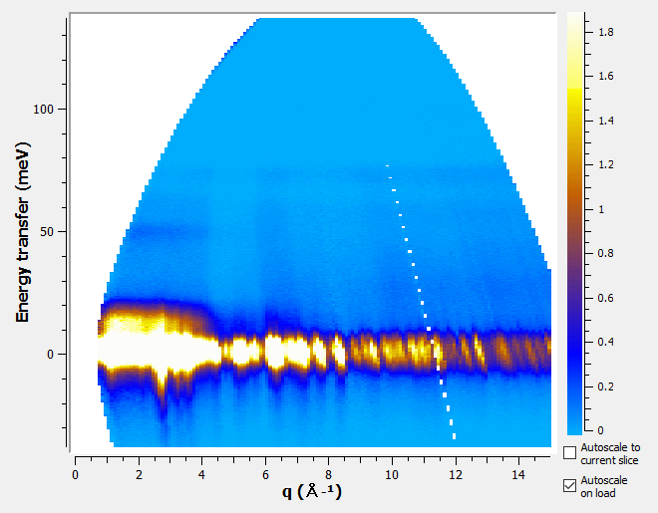
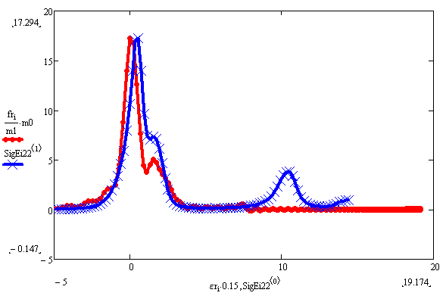
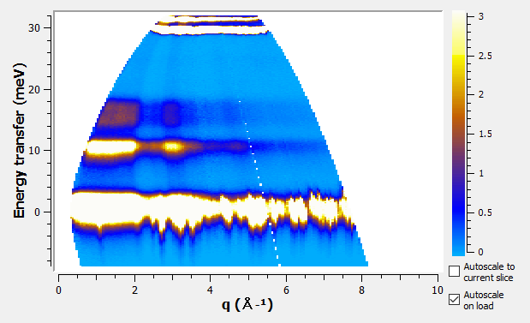
Work in progress:

